Slide 1
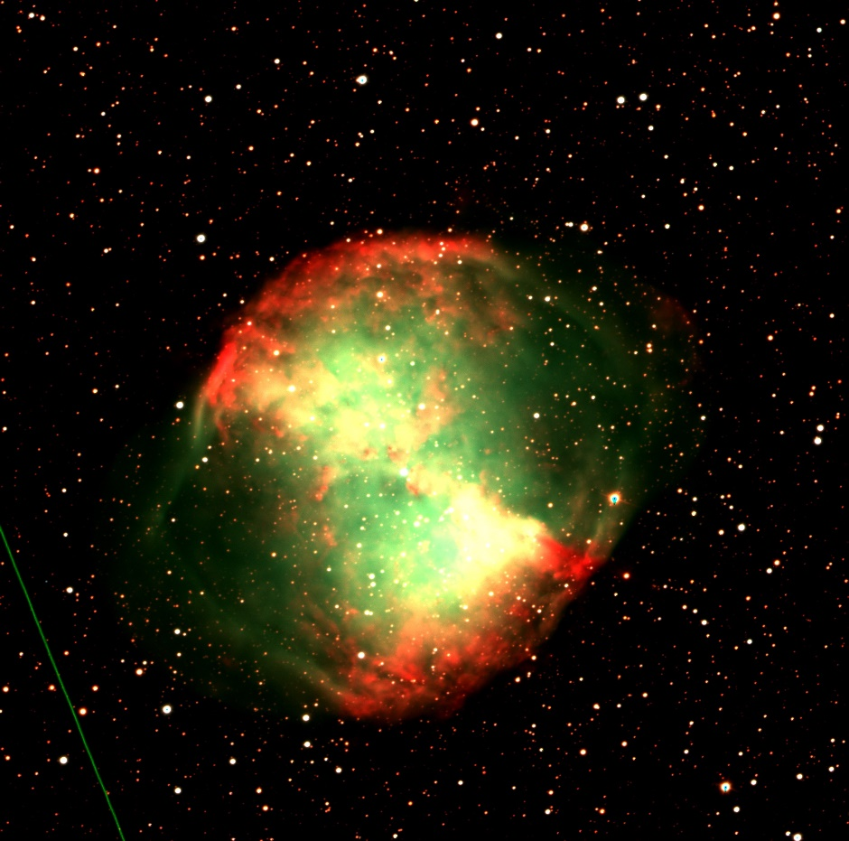
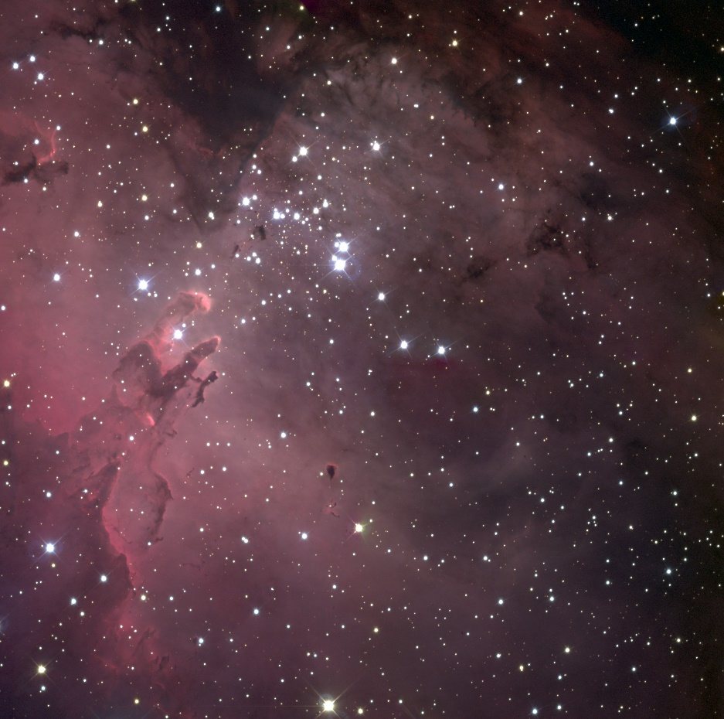
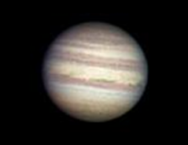
3 Colour Imaging
Notes:
There are no notes for the title page.

Slide 2
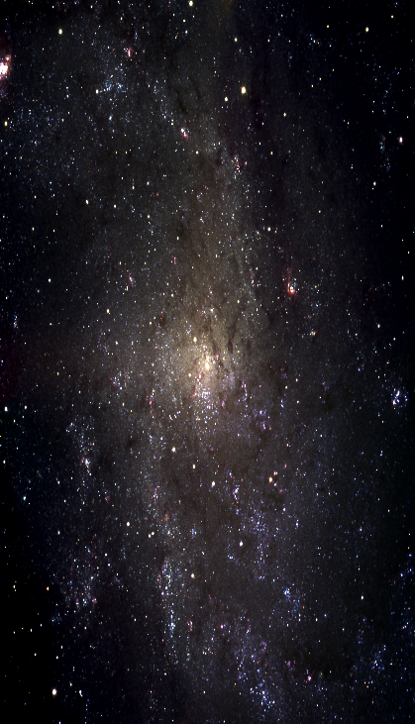
Overview
What really are colour images?
  Colour cameras and CCDs
  Components of colour Images
  Recreating colour Images
Astronomical cameras and filters
Representative colour images
3-Colour images
Colour image of the spiral galaxy Triangulum
Notes:
Students will be introduced to the concept of 3-colour imaging.
Colour images in both traditional digital photography, as well as astronomical digital imaging are explained.
Students are presented with a selection of images taken using different filters and are asked to work out which ones were taken with which filter.
A set of activities is presented that can be carried out using LTImage

Slide 3
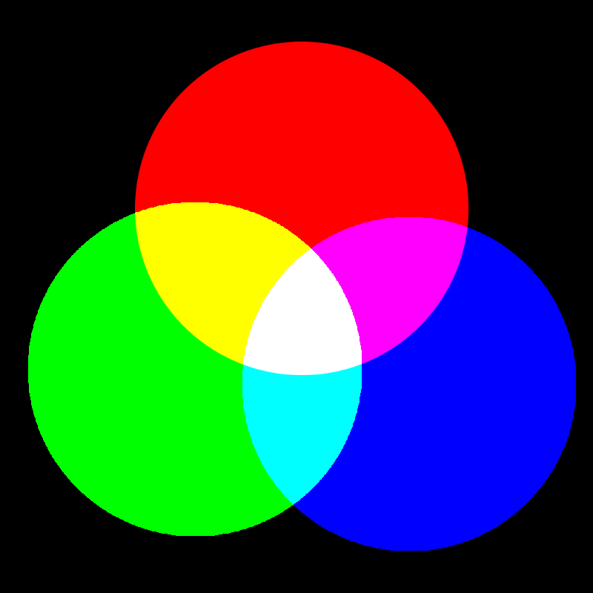
All light is made up of 3 primary colours: Red, Green and Blue
Notes:
Your eyes can see 3 colours: red, green and blue.
Your eyes see the intensity of light in each of these colours and your brain combines and interprets the information to make all of the different colours you can see.
The diagram shows how red, green and blue mix to make other colours.
Your computer monitor produces colour images by using red, green and blue dots. At normal viewing distance from the monitor your eyes can’t see the individual dots and your brain sees a colour image.

Slide 4
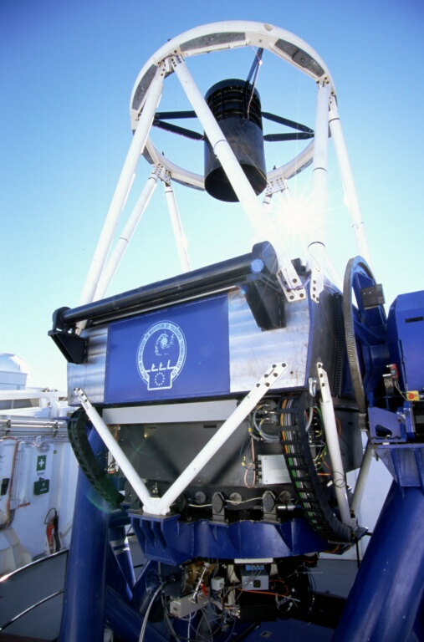
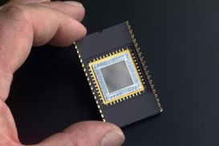
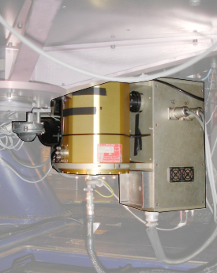
CCD Chip
NASA
The CCD on the Liverpool Telescope is located
in the IO:O Detector.
Notes:
Ordinary digital cameras, such as the type you might have at home or on your mobile phone, produce colour images by recording the intensity of red, green and blue light in the same way that your eyes do.
The part of the camera that detects light is called a charge coupled device or CCD. It is usually part of a computer chip on a circuit board (image top right).
In astronomical telescopes, the light from objects (stars, galaxies etc.) is collected by large mirrors or lenses and focused down to produce a tiny image on the CCD.

Slide 5
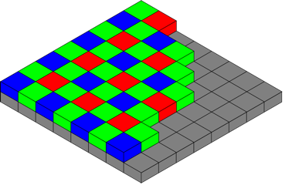
Colour Cameras and CCDs
Colour CCD’s like those found in digital cameras and mobile phones have pixels (shown in grey) with red, green and blue filters over them which they combine to create the ‘real’ colours we see.
Notes:
The CCD is made up of very small light sensitive areas called pixels. In the diagram they are shown as grey squares.
Each pixel can see a wide range of colours and it records the brightness (or intensity) of all of the light that falls on it before converting it to a number. However, this doesn’t give us a record of the colours in the scene being looked at. For that we need to use filters.
Red, green and blue filters are placed over different pixels so that the intensity of red, green and blue light falling on those areas can be measured. In this way, we can be sure that we know something about the individual colours in the scene being photographed rather than just the overall brightness of all the colours. The red, green and blue arrangement above is called the Bayer pattern.

Slide 6
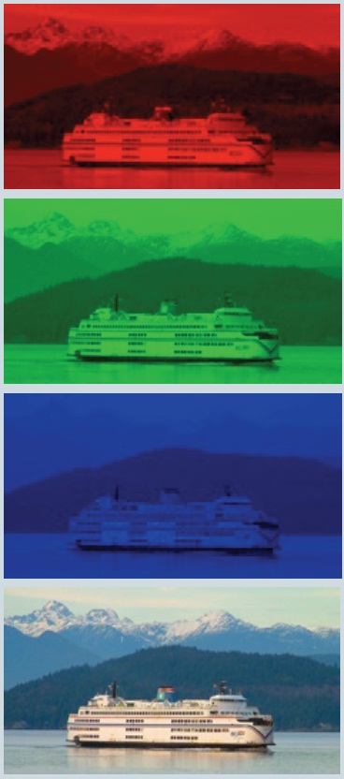
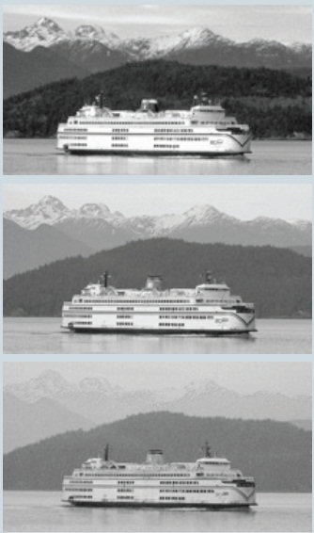
The light hitting each pixel (or light bucket) is given colour by passing through the filter
Red filtered image coloured Red
Green filtered image coloured Green
Blue filtered image coloured Blue
Red, Green and Blue images combined
Intensity of light coming through the Red Filter
Intensity of light coming through the Green Filter
Intensity of light coming through the Blue filter
Notes:
This slide shows the intensity of light as seen by the CCD through each of the red, green and blue filters.
The images on the right are the same images as on the left, but are coloured red, green and blue to give them back their colour.
The image on the bottom right is each of the 3 coloured images combined to re-create the original scene.

Slide 7
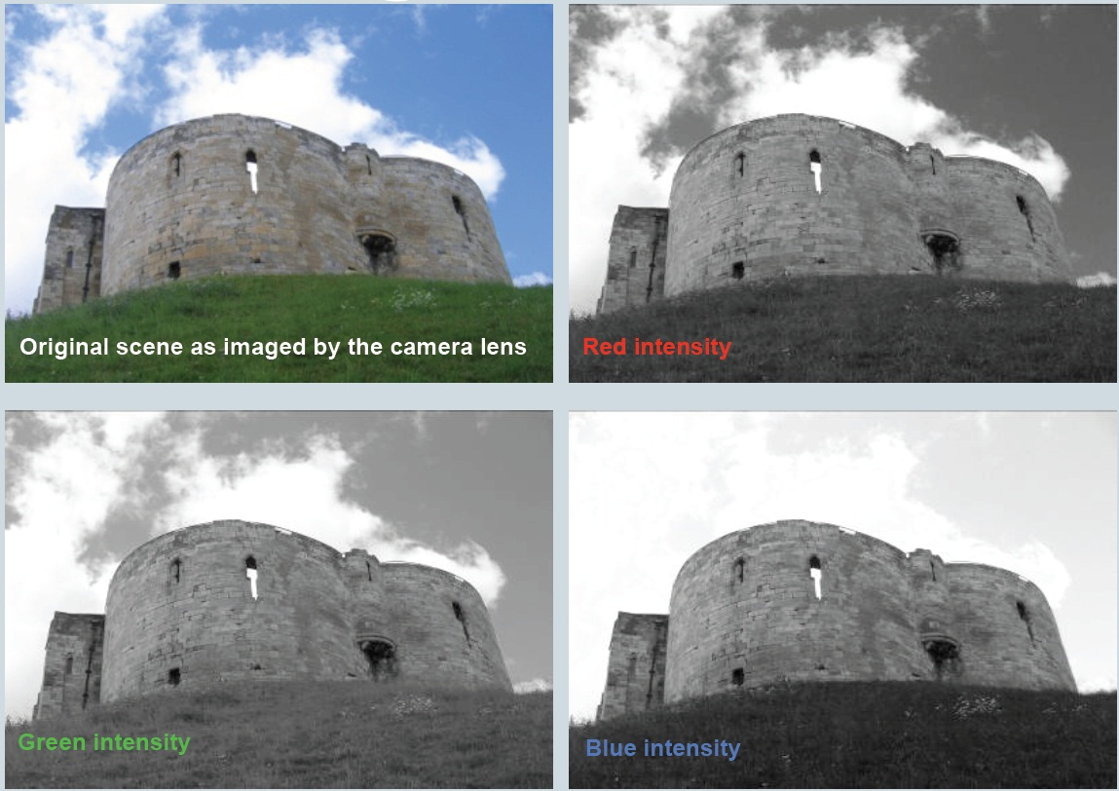
The lighter (or more white) the image looks in the filter the more of that colour is present.
Notes:
Here you can see 3 black and white images. These represent the intensity of red, green and blue that is present in the image at the top left.
The image top left represents what the lens of the camera sees, the red, green and blue images represent what the CCD in the camera records.

Slide 8
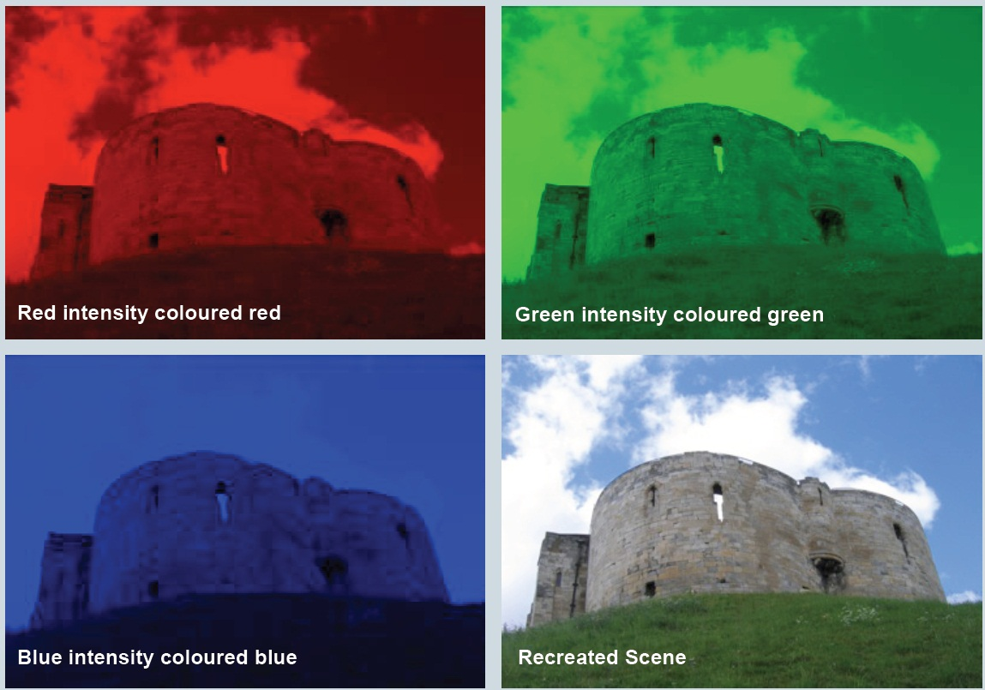
The dark (or more black) the image looks in the filter the more of that colour is blocked.
Notes:
Here you can see 3 single colour images. These red, green and blue images are made from the images on the previous page that show intensity in these colours.
They are then combined to re-create the colour image on the bottom right.

Slide 9
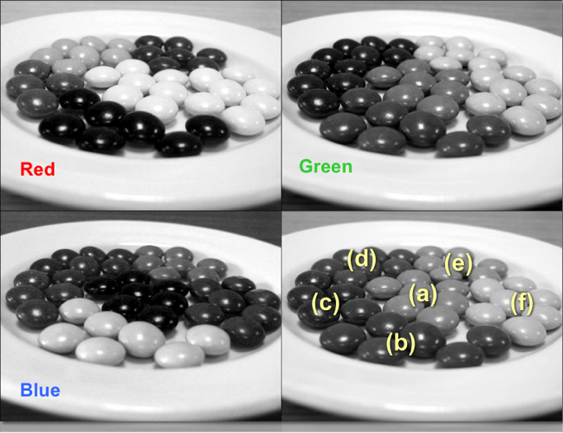
Can you work out the colour of the sweets at each of
the labelled positions in the bottom right image?
Notes:
You have seen 2 sets of colour images that explain how CCDs detect the intensity of light, and how cameras can then reconstruct these images to re-create the original scene.
Using this knowledge, you can work out the colour of each group of sweets in the image opposite.

Slide 10
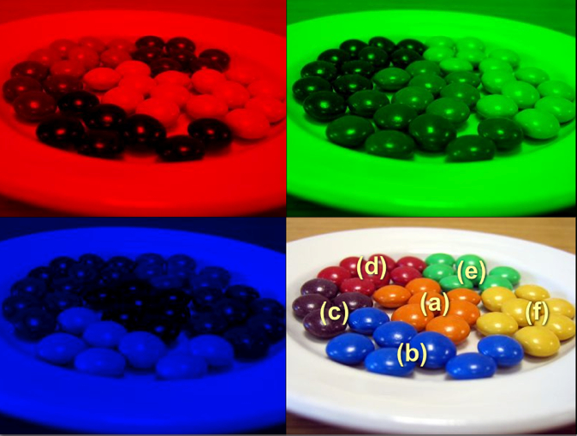
The Answer!
Notes:
The answers shown with letters.

Slide 11
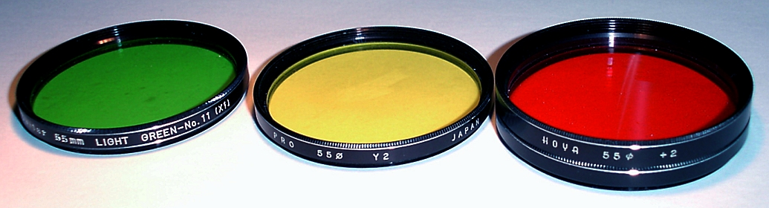
IO:O is the CCD camera on the Liverpool Telescope
It also has an array of pixels (4096 x 4112) but instead of the filters sitting over alternate pixels they sit in front of the whole camera.
The Liverpool Telescope has 12 different filters which let in different wavelengths, or colours, of light.
Notes:
Cameras on astronomical telescopes are different to consumer digital cameras in a number of ways. In particular, astronomers want to be able to record light from more than just the red, green and blue wavelengths. This means a fixed set of red, green and blue filters over the CCD pixels is impractical.
Instead the CCD is made so that it is sensitive to a wide range of wavelengths of light, including some we cannot see with our eyes. Filters are then placed in front of the whole CCD to block wavelengths that astronomers are not interested in, so they can get a “picture” of what an astronomical object is like in a particular wavelength.

Slide 12
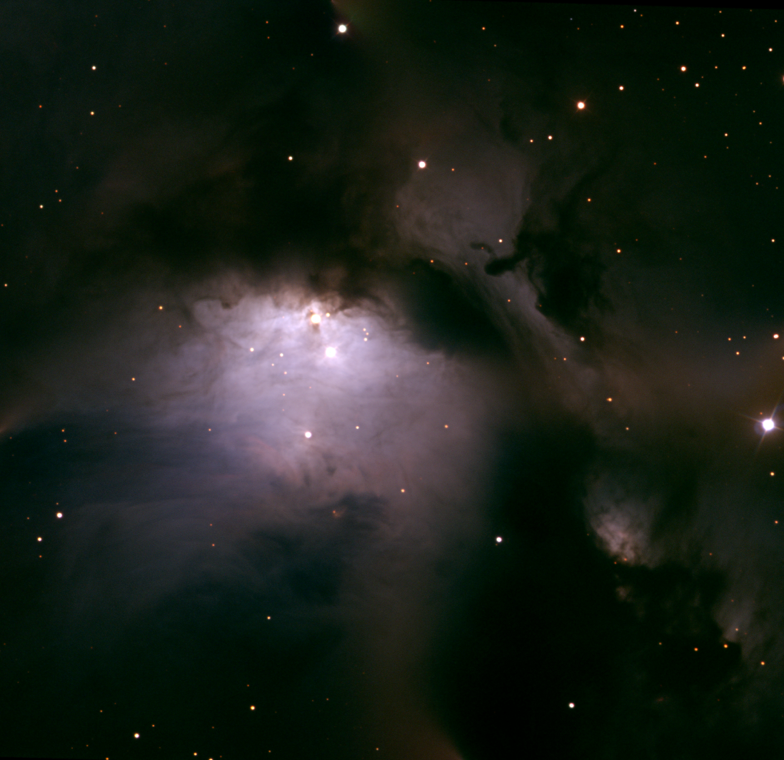
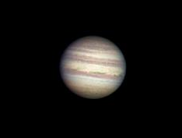
Jupiter
© 2005 A .Newsam & the LT project.
Part of Messier 78
Combination of R, B and V filter observations.
© 2016 A. Newsam
Notes:
Most of the time astronomers are not interested in getting a “true colour” image of the astronomical object they are looking at. This is because their research does not require images in red, green or blue.
However, colour images can be useful for a number of reasons. Sometimes colour images are used to make certain features easier to see. At other times colour images can be used to show wavelengths that we cannot see with our eyes but are important in understanding the science that is going on in the picture.
Messier 17 is an observation taken with 4 filters (rather than 3), and one of the filters is infra-red, a wavelength we cannot see with our eyes. Therefore this is not a “true colour” image at all.

Slide 13
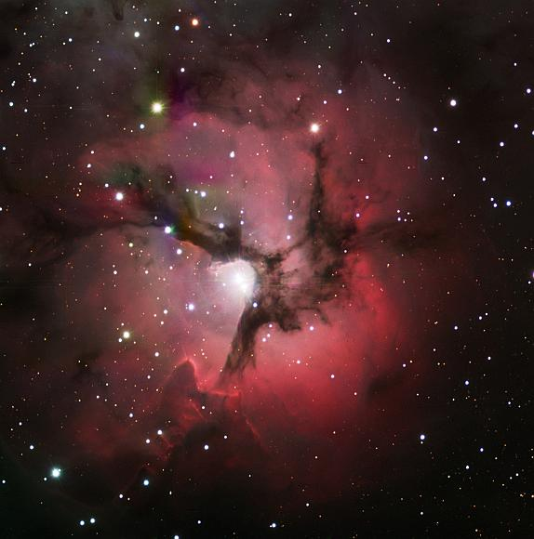
The image of M20 (above) is a combination of 3 filters that are broadly red, green and blue. This is a “representative colour” image.
M20. Mosaic of r', V and B observations.
© 2008 A .Newsam, Bryn Davies & the LT project.
Notes:
As we have seen, cameras are not the same as our eyes, and in the case of astronomical cameras the filters they use do not correspond exactly to the red, green and blue that our eyes see. Therefore it is difficult to claim that the astronomical images we produce are “true colour”.
However, by choosing 3 filters that are roughly in the correct part of the spectrum, we can produce a “representative colour” image. This is an image where the colours we add to the observations before we combine them (i.e. red, green and blue) are broadly “representative” of the colours of the filters we used when we observed.
The image of M20 (above) is a combination of 3 filters that are broadly red, green and blue. This is a “representative colour” image. The colours can also tell us something about the science that is going on inside this nebula. This is another good reason to use colour in astronomical images.

Slide 14
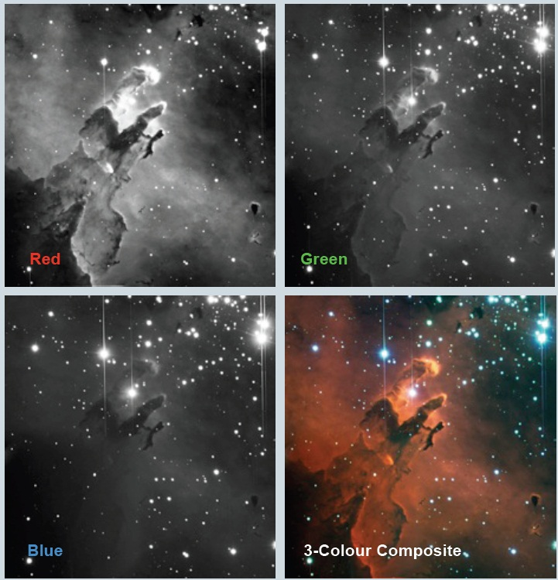
The Eagle Nebula (a mosaic).
© 2004 A. Newsam & the LT project.
Notes:
These images show the red, green and blue filtered images from a set of observations made by the Liverpool Telescope.
When they are coloured and combined to produce a representative colour image, we get the image that is bottom right.
You can spend a lot of time producing colour images and tweaking them to look pleasing or to bring out the science you want to explain in your picture.
This 3-colour imaging process is one of many used by astro-imagers who spend many hours producing the pictures we see in books, on TV and on the Internet.
You can learn much about light, colour and imaging techniques by spending some time producing your own 3-colour images.

Slide 15
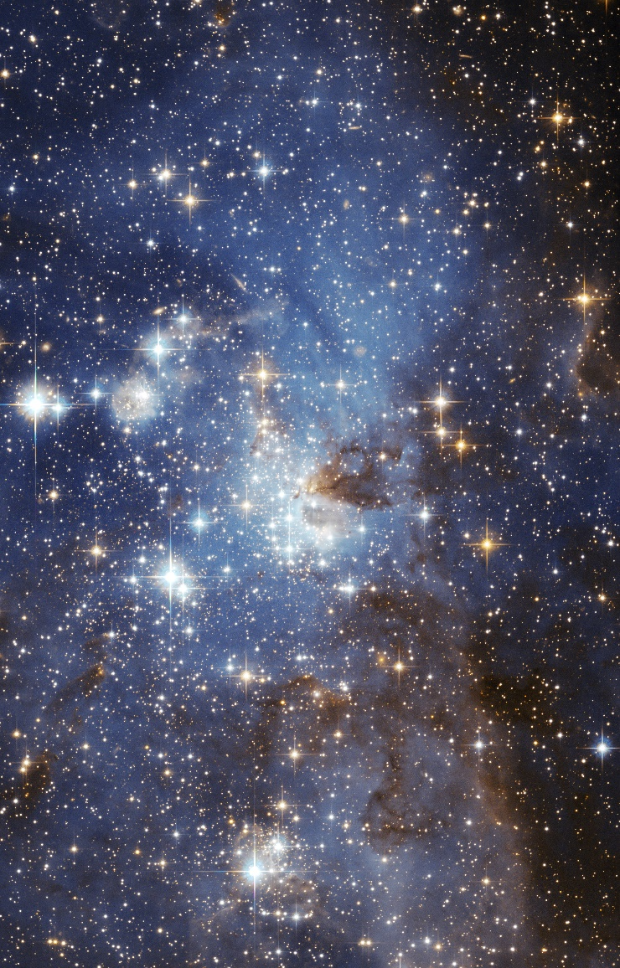
Colour in Astronomy
We not only use colour in astronomy to make things look attractive but to get information:
  Red colours in stars are old and cold, blue stars are hot and young
  Gases of certain colours are created by the chemicals within them: for example when hydrogen gas gets hot it emits red light, oxygen emits green
  When objects move away from us their light moves into the redder part of the spectrum (redshift), and when they move closer the light moves to the blue (blueshift) – the amount of shift indicates the distance to the object

Slide 16
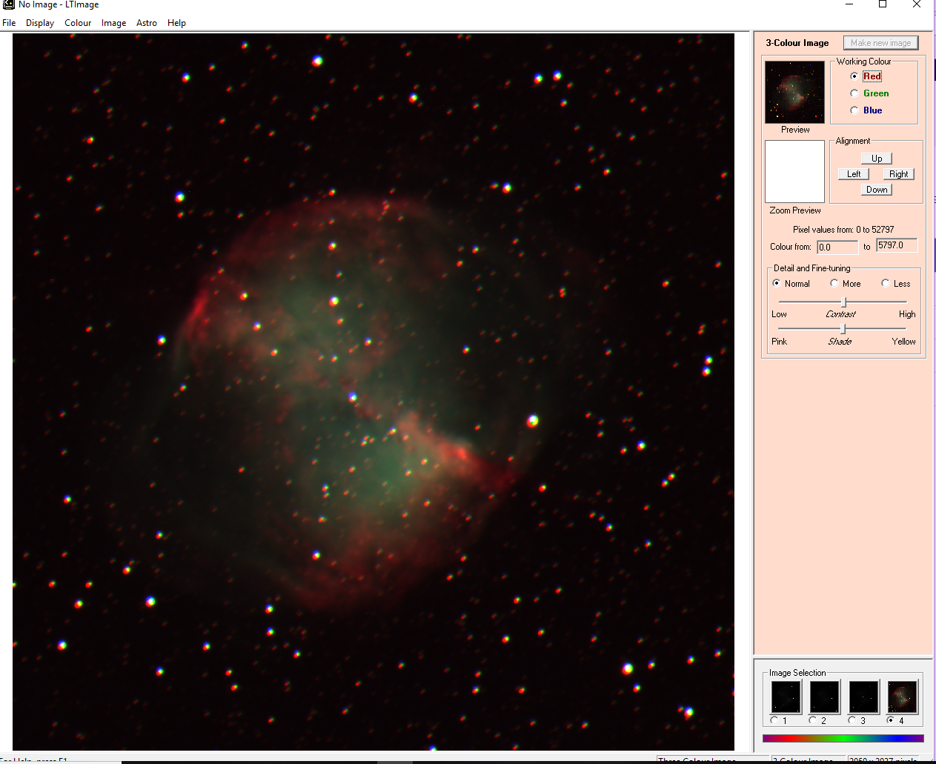
Activities
Try producing a 3-colour image in LTImage using the sets of images supplied with this workshop.
You can choose one or more of the following sets:
  M51 – Whirlpool Galaxy
  M27 – Dumbbell Nebula
  M1 – Crab Nebula
  NGC7635 – Bubble Nebula
All of the images are provided in the FITS format that LTImage recognises. Some will require scaling, whilst others will not. All will require a variable amount of alignment.
Instructions for using LTImage are on the NSO website.
Image being aligned in LTImage
Notes:
No notes for this slide.

Slide 17
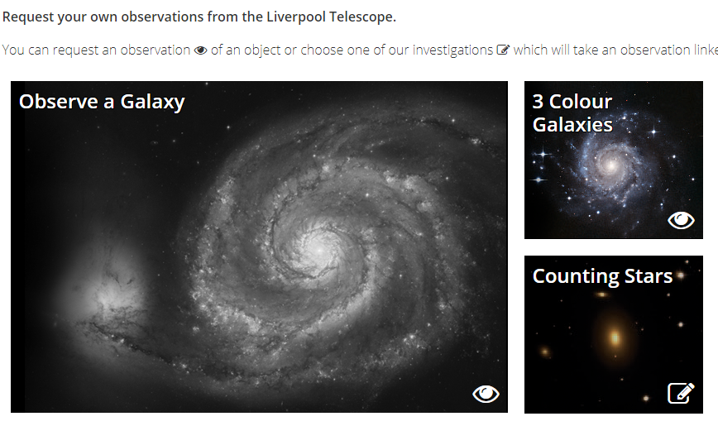
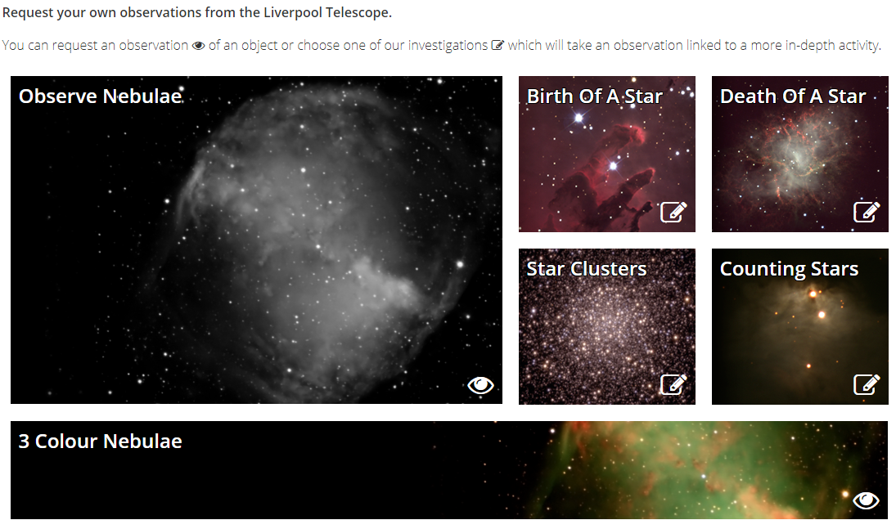
Activities
You can use Go Observing to get your own sets of red, green and blue images from the Liverpool telescope. You can then use the NSO’s LTImage software to combine the 3 observations to make your own 3-colour images.
Requesting a 3-Colour Observation in Go Observing
Notes:
No notes for this slide.

